Slide 1
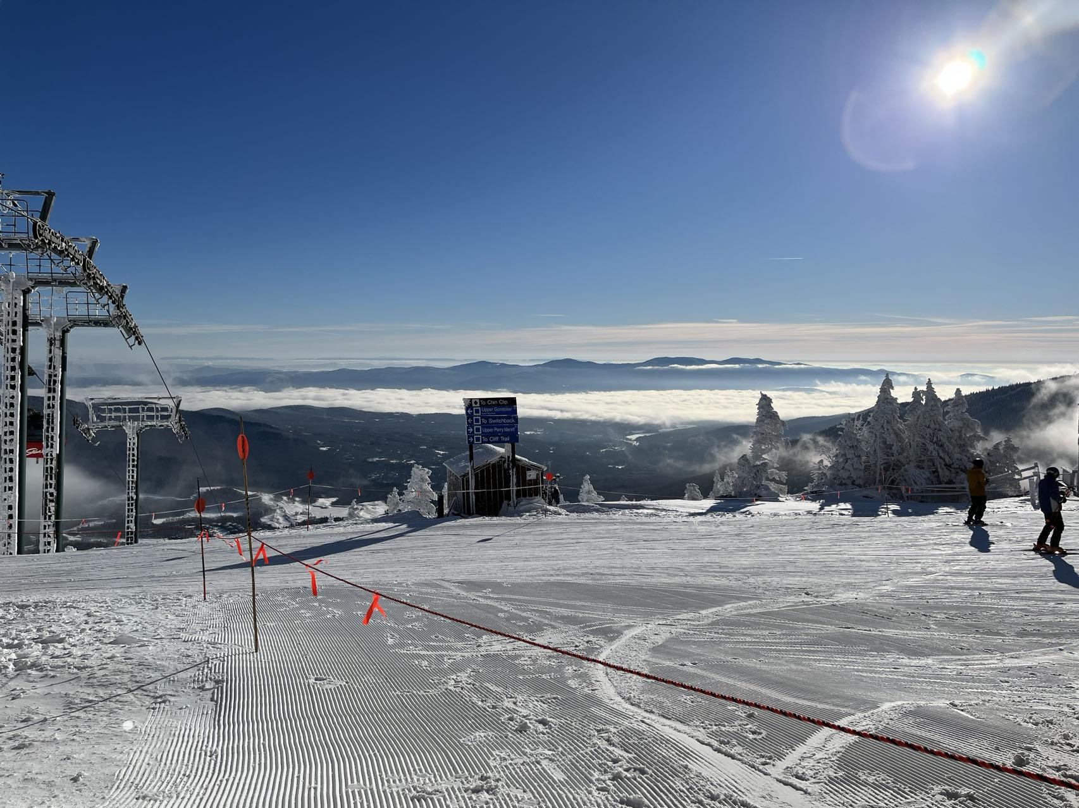
ShouldISki
Team Tuesday and Thursday
Siyi Du
Sicheng Chen
Team GitHub Repo:
csc0007/CS501_GroupWork: Group Work Only (github.com)

Slide 2

Overview/Introduction
A ski trip recommendation app that gives user information about:
Snow Condition
Weather
Crowd Index
Hotel Availability
Traffic Condition
Travel Time
Overall Recommendation Index
Motivation/Purpose
Be prepared for your ski vacation

Slide 3
Implementation Details

Slide 4
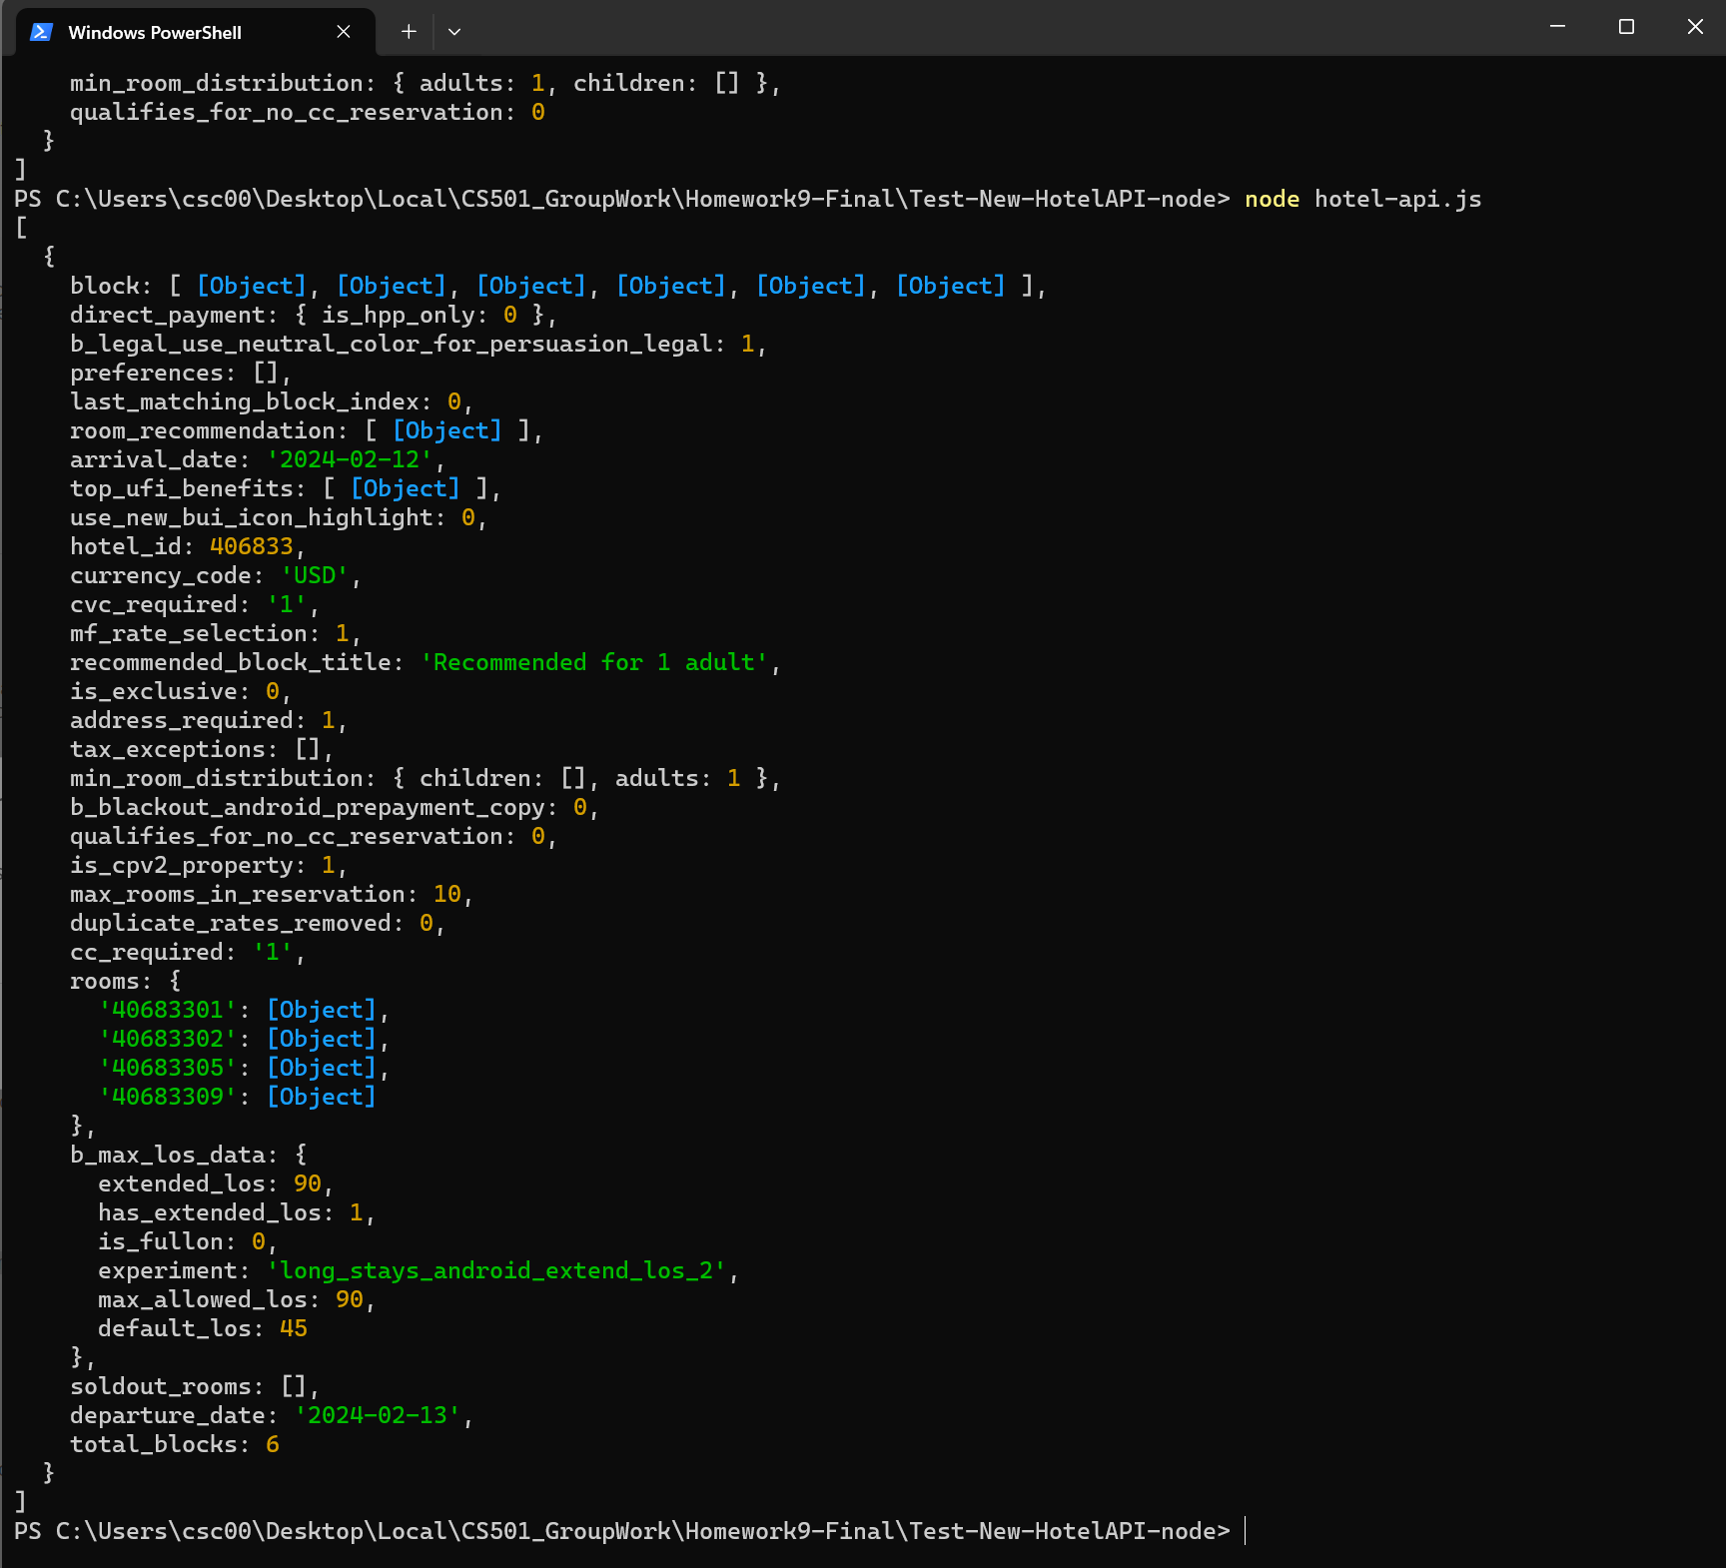
Roadblock 1
Hotel API does not have direct hotel availability data
Booking.com Room list of the hotel API Response
Workaround
Make two API calls:
1. Get selected date room list
2. Get 3 month later room list – assume this list reflect empty status
room_count
__________
3m_room_count
X100%

Slide 5
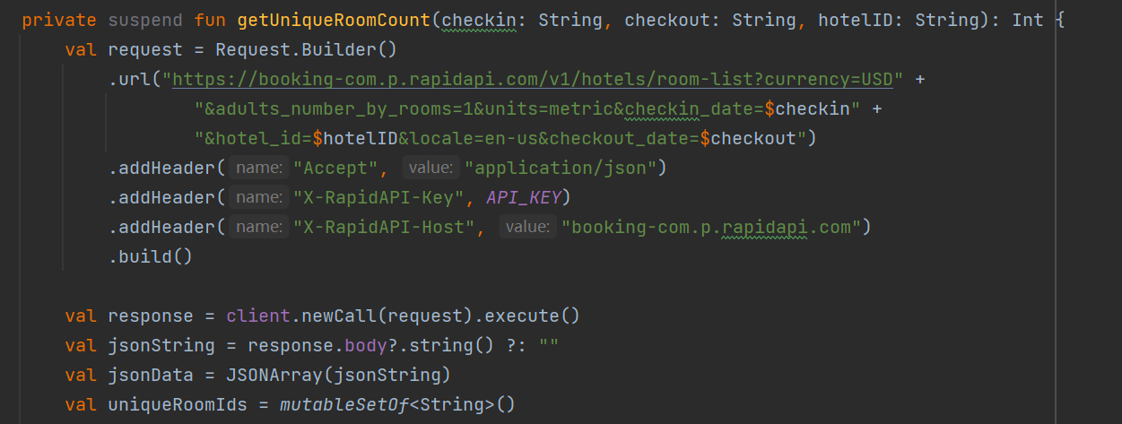
Booking.com Room list of the hotel API Response
Roadblock 2
No API handbook for Booking.com API:
1. Not available for general public
2. Different hotel have different booking policy
Workaround
1. Booking.com Search Hotel by Coordinates API
2. Google Map
3. Booking.com Webpage Search

Slide 6
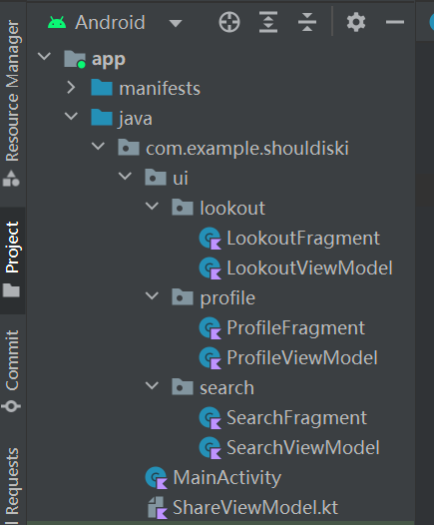
Roadblock 3
Data sharing between fragments
Workaround
1. Use ShareViewModel
2. Use LiveData and Observe

Slide 7
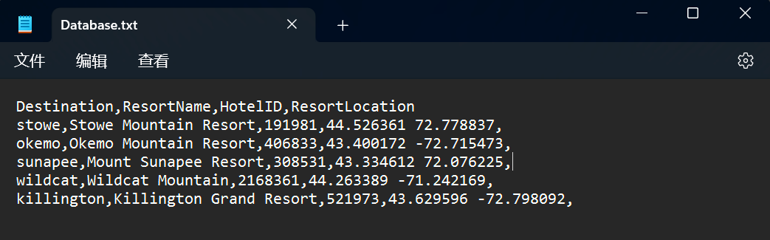
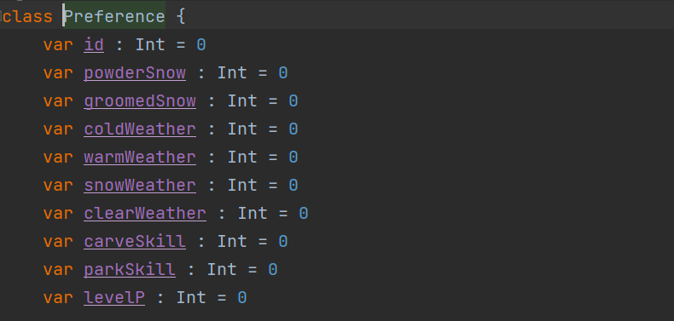

CSV Format .txt Initial Data for Resort Database
Roadblock 4
Database Setup
1. Supported Resort Database
2. User Preference Storage
Solution
1. Two database with SQLite – Resort and Preference
2. YouTube Tutorial
3. Slightly different for two database and Database handler
Preference Database Structure
This Database only have one Entry

Slide 8
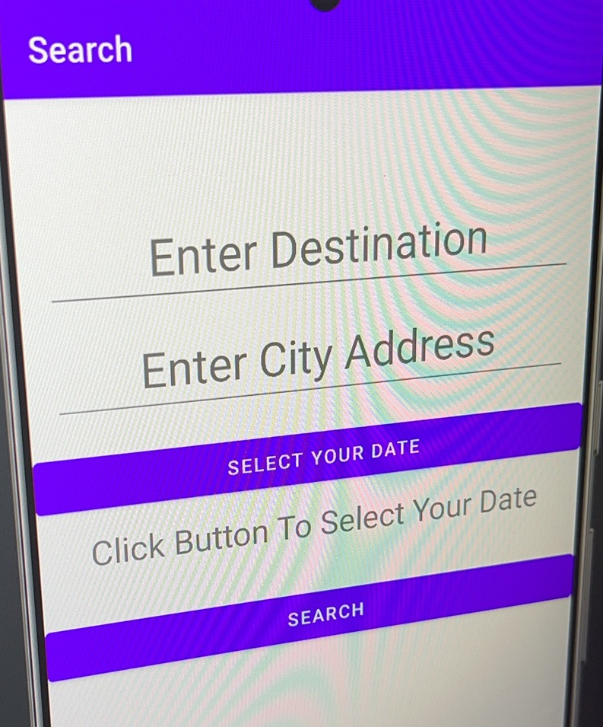
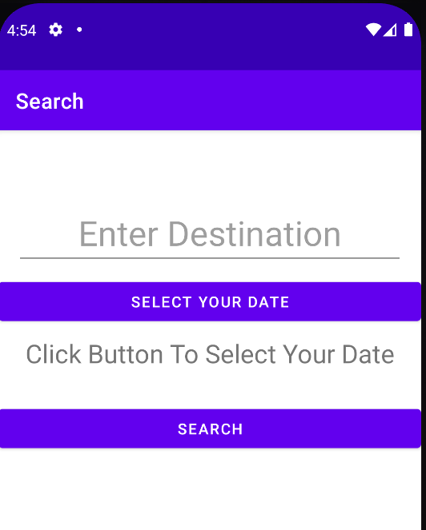
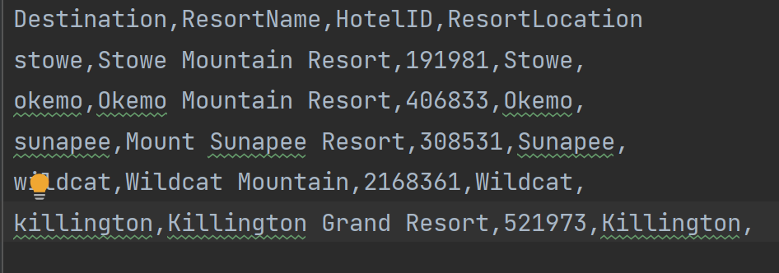
Roadblock 5
Weather API Integration
1. Weather API need to receive city name.
2. Users input ski resort name.
Workaround
1. Considered entering both resort name and city name.
× Simplicity of use
2. Save the city name corresponding to the ski resort in the database and call.
Implementation Details

Slide 9
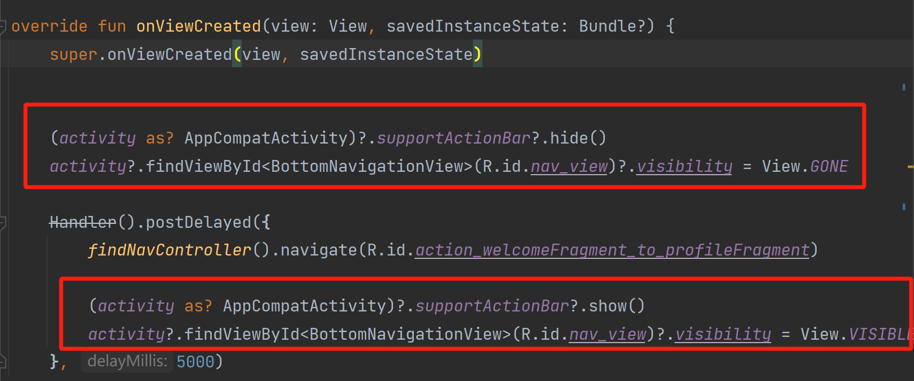
Roadblock 6
Welcome Page
1. Hide action bar and nevigation bar.
2. How to stay for some periods and continue to show main page.
Implementation Details
Workaround
1. The bottom navigation bar is located using its ID (R.id.nav_view) and its visibility is set to View.GONE to hide it.
2. When navigating away from the WelcomeFragment, the visibility of the bottom navigation bar is restored to View.VISIBLE.

Slide 10
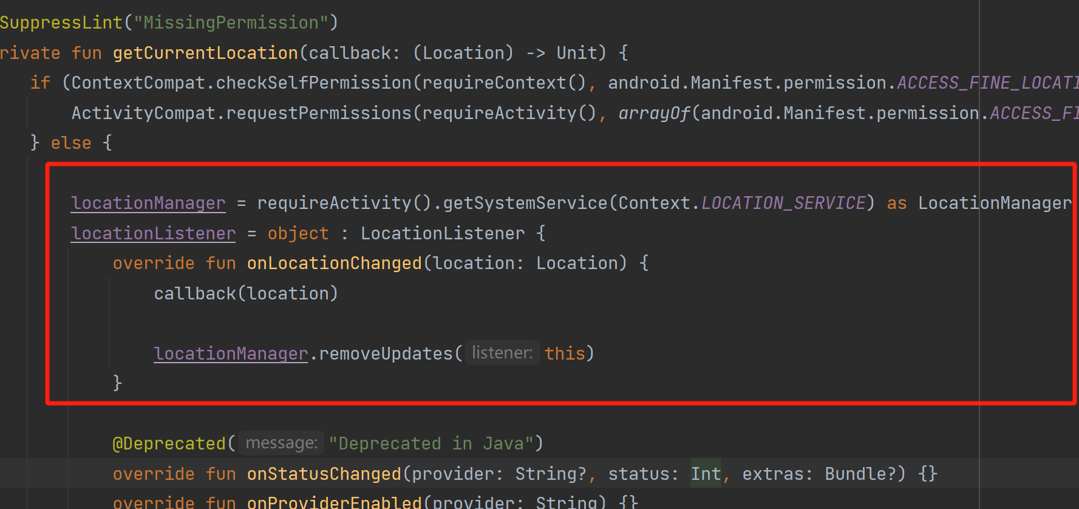
Roadblock 7
Current Location
Unstable to get current location.
getLastKnownLocation vs LocationListener
Implementation Details
Workaround
1. I first used getLastKnownLocation ,which might return null if there's no recent location data available.
2. A more reliable approach is to request location updates.

Slide 11
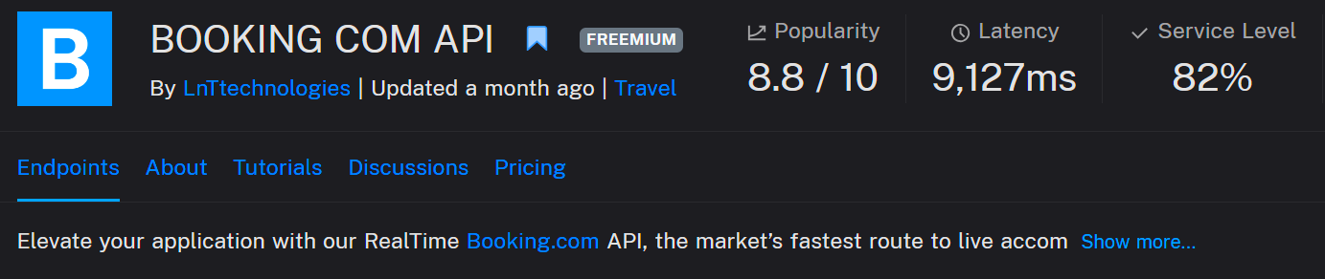
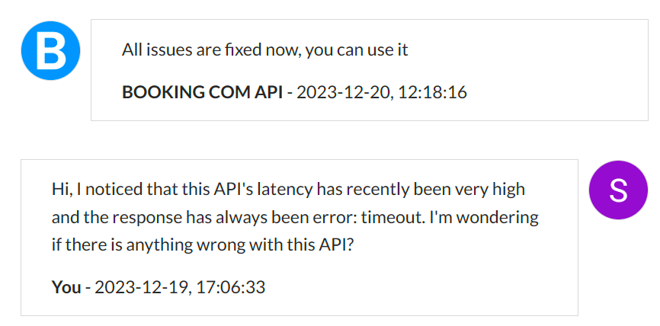
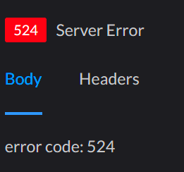
Surprises
Booking.com Third Party API Provider Server Outrage
That’s a lie….☹
Workaround
Emergency search for another API provider
Code modifications for new API Interface
Reorganize API response parsing

Slide 12
What would you do differently?
Use ChatGPT API for personalized recommendations

Slide 13
Future Work
Develop a more precise and personalized recommendation algorithm
Better UI design
Loading Dialog
Support for more resort
Implement language switching system

Slide 14
User Story
Accomplished Functions
User is able to check weather status
User is able to check snow condition
User is able to check traffic status
User is able to check travel time to the resort
User is able to check hotel status
User is able to check anticipated crowd index
7. User is able to check other snow resort
8. User is able to get personalized recommendation

Slide 15
Summarize
Our project involved the development of 4 APIs, each presenting its own set of challenges. Notably, the Map API and Hotel API were particularly complex, requiring us to overcome numerous difficulties. During the development of the Weather Query API, we addressed over a dozen issues, experimenting with 3 different APIs before finally arriving at an ideal solution.
During our midterm presentation, professor commended the ambitious design and complexity of our project, acknowledging the extensive functionality and intricate details it comprised. This appreciation and encouragement from our professor have been a great source of motivation. Over the past month, our team has dedicated itself to the meticulous completion of this final project.
Given that our group consists of only 2 members, the workload for each of us was effectively double the norm. However, our collaboration has been exceptionally smooth, with frequent Zoom meetings, timely communication through WeChat, and face-to-face discussions.
Upon completing the project, we further optimized and refined our work, ultimately resulting in the flawless creation of the ShouldSki APP.

Slide 16
Demo

Slide 17
ChatGPT Prompt
Can I click the imageView and set an onClickListener? Just like the way clicking a button?
How to set a minimal dialog? I want to reuse a dialog for multiple use cases, what is the best way?
Can I handle two database in one database handler?
So you suggest that for handling two different database, the good approach is to create two databaseHandler?
Does Kotlin support conversion from boolean to Int?
How to find if a string value is inside a longer string?
Other debug information, e.g. What does this error log ”xxxxxxxxx” means?
Reference
1. Android Tutorial (Kotlin) - 30 - SQLite Database Creation and Insertion - YouTube
2. Booking com API Documentation (tipsters) | RapidAPI

